Slide 1
pandas and A2
Learning goals:
Understand the Series and Data Frame data structures.
Learn how to use Google.
Learn how to read pandas documentation.
Make progress on A2.
COGS 108 Fall 2020
Atman Patel
Discussion 4
a2patel@eng.ucsd.edu
OH: Tue 11:30am to 12:30pm

Slide 2
Welcome to the wonderful world of pandas!

Slide 3
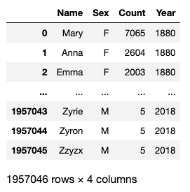
Pandas is really useful!
It converts python into a usable (and good!) data analysis tool

Slide 4
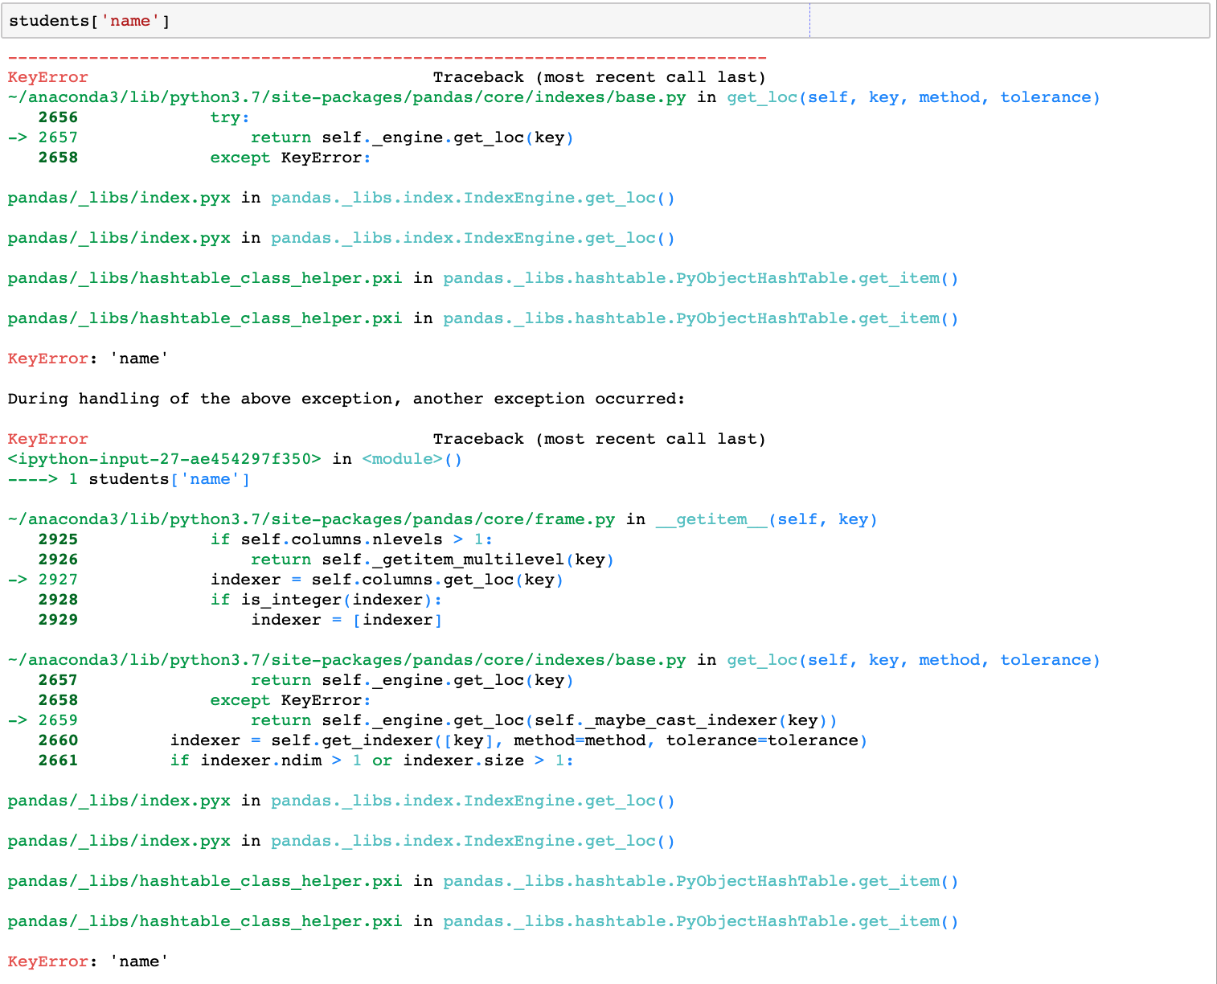
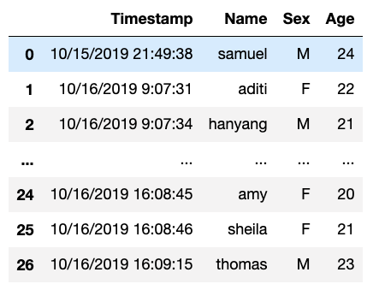
Pandas has terrible error messages

Slide 5
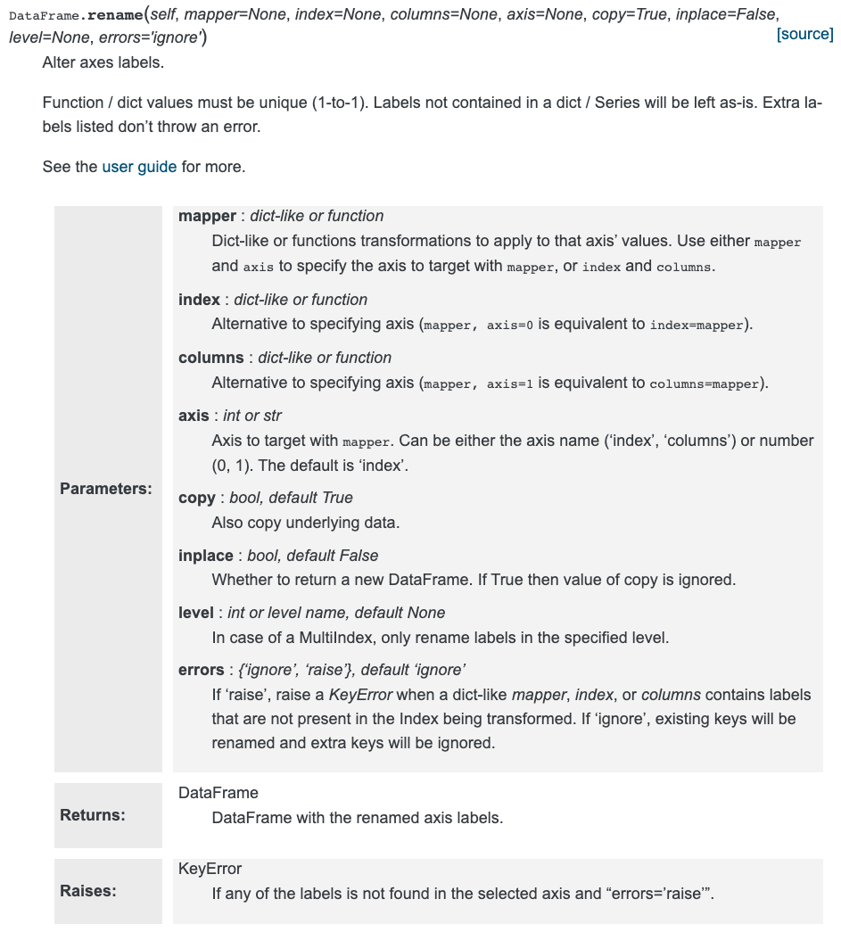
Pandas has unfriendly documentation
Also, there are typically many ways to do the same thing in pandas.

Slide 6
3 skills that will save you 5+ hours on A2:
Knowing the difference between a pandas Series and Data Frame.
Knowing how to use Google effectively.
Knowing how to read the pandas documentation.

Slide 7
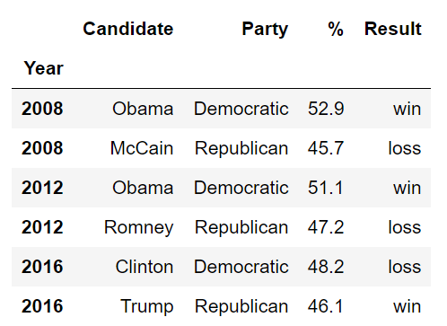
What’s a Data Frame?
Data Frame: two-dimensional table of data.
All columns are the same type (but not rows).
Every row and every column has a label.
We call the set of row labels the Index of a DataFrame
Index

Slide 8
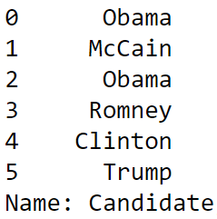
What’s a Series?
Series: one-dimensional sequence of data.
Usually created by taking a single column from a Data Frame.
Index

Slide 9
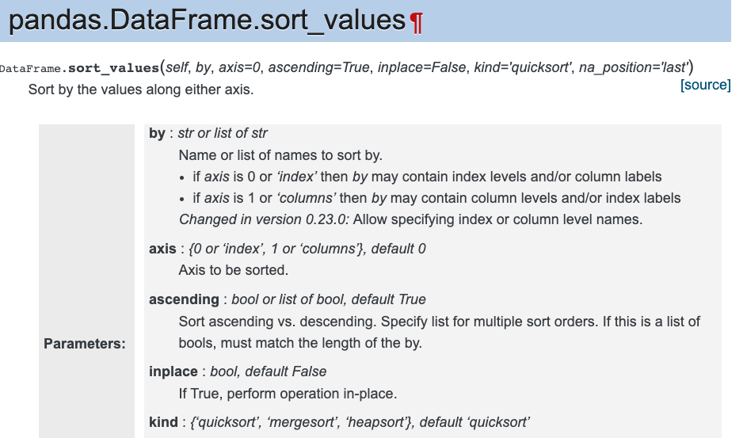
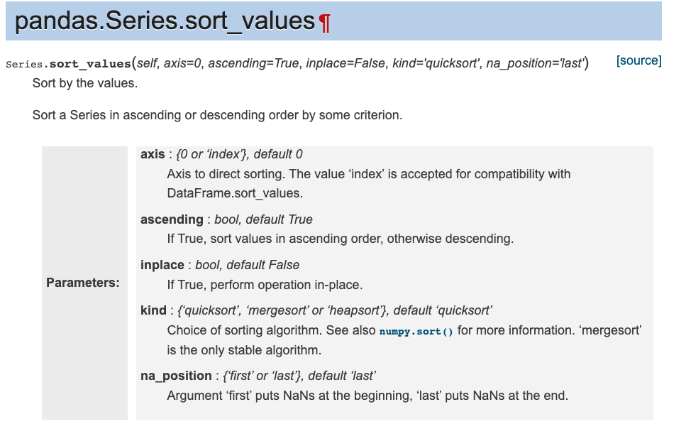
Why is this important?
Most pandas methods work differently between Data Frames and Series.
The documentation will tell you what type of object the method is for.

Slide 10
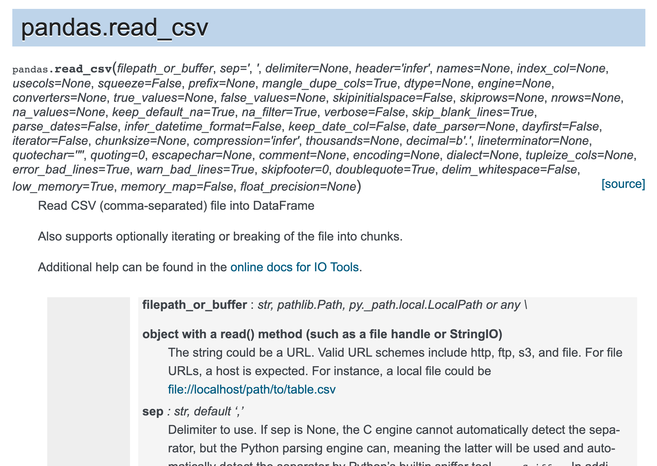
Why is this important?
df.sort_values(…)
df[‘names’].sort_values(…)
pd.read_csv(…)

Slide 11
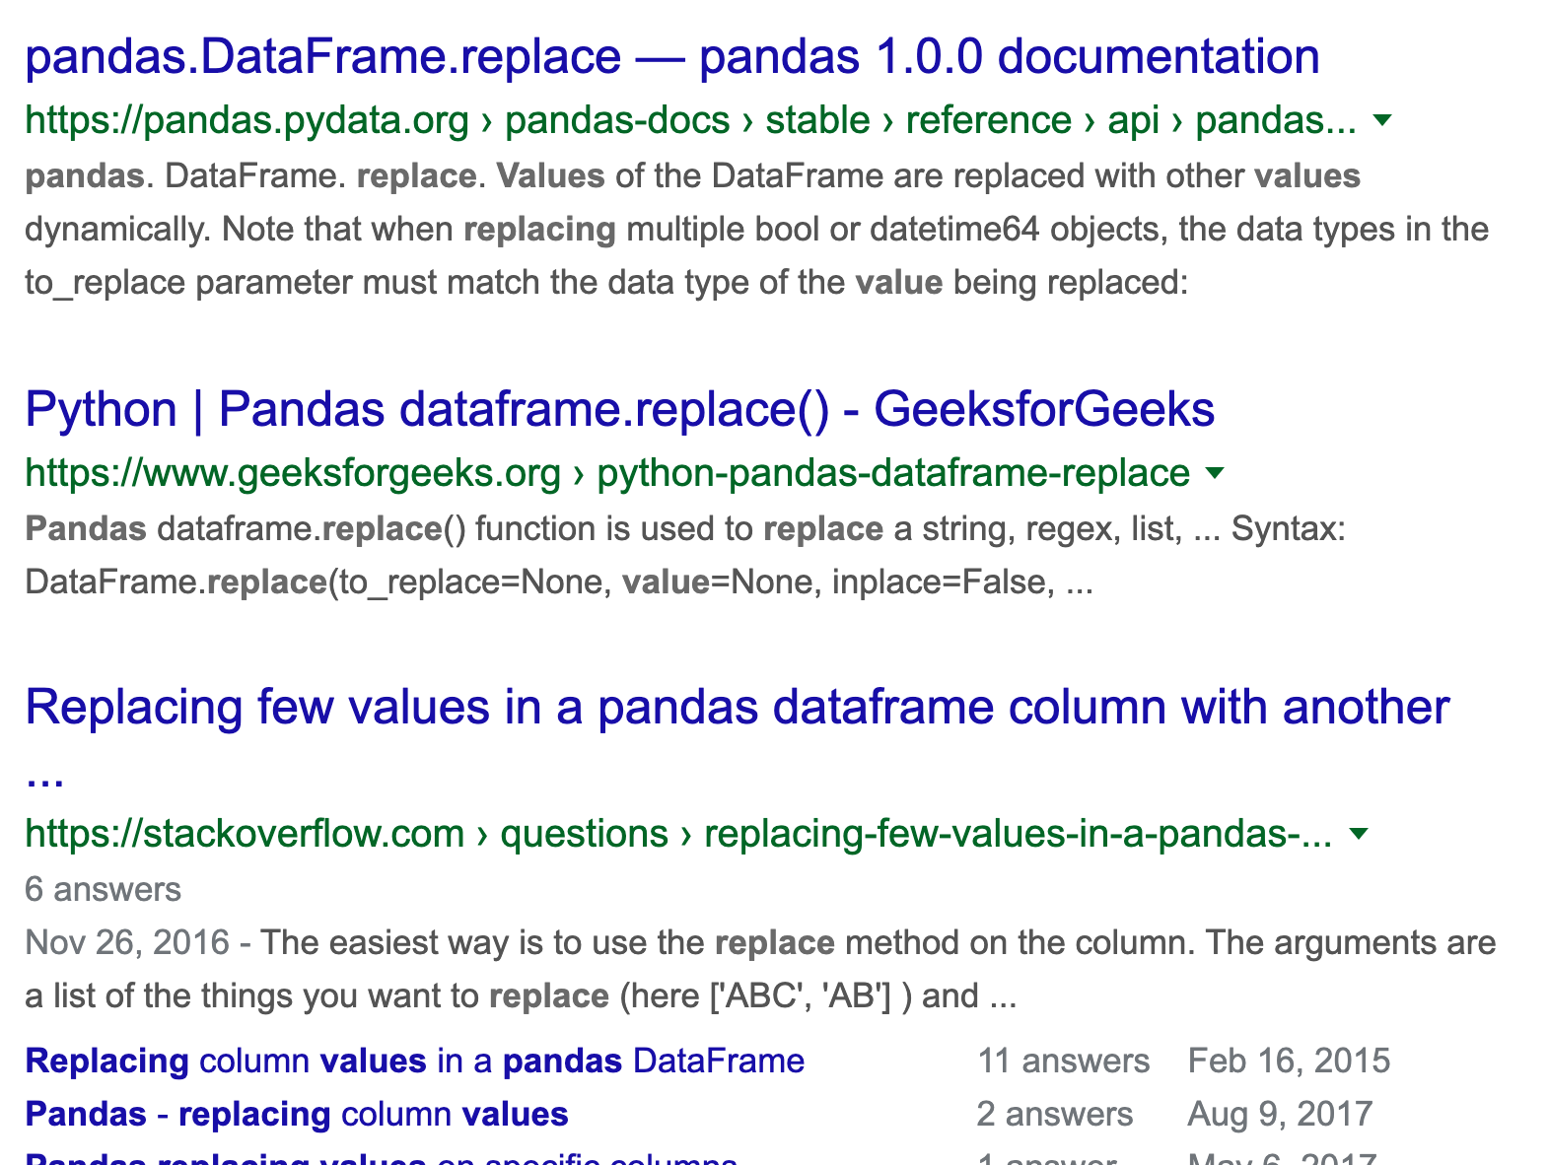
How to use Google properly
State your task: “I need to replace 0 with False and 1 with True.”
Remove question-specific details: “replace values”
Add the package name to the front: “pandas replace values”
If you already know the right method, just google “pandas replace”
Cheatsheets can help you find the right method

Slide 12
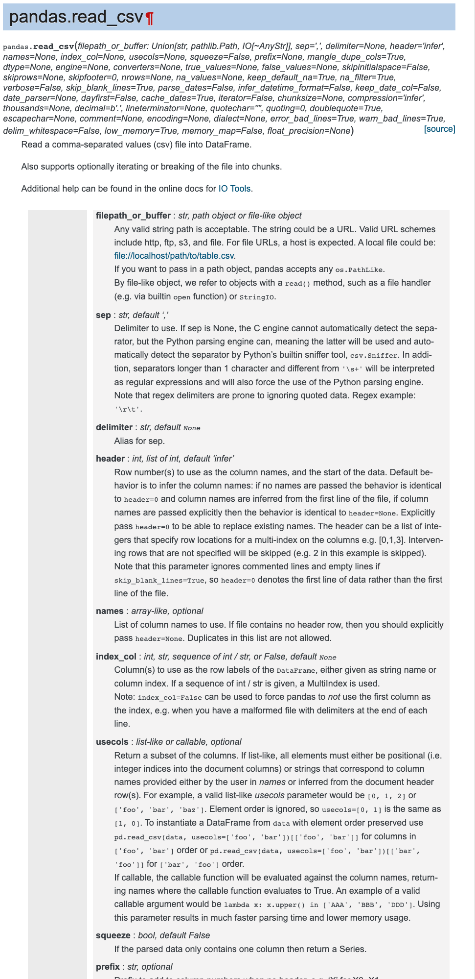
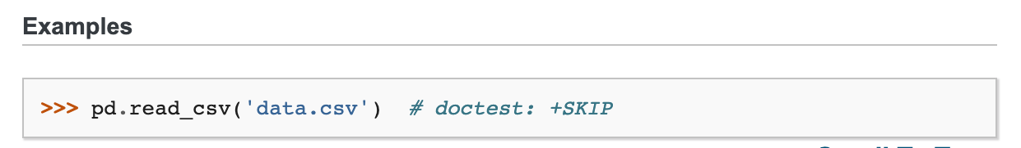
How to read pandas documentation
Skip the table of method parameters and look at the examples.
Copy example, then modify it to work for your notebook.
If needed, refer back to the method parameters for fine-tuning.
(The method in the picture on the right solves Q2.)

Slide 13
Finally: don’t use loops
If you find yourself trying to write a for/while loop when working with pandas, you’re almost definitely doing it wrong.
Look for the right pandas method. And ask your friend + staff for help.

Slide 14
Preview of next week
Why do cells work the first time but not the second?
Why are there so many brackets everywhere?
String methods: how do I work with text?
Demo: using last letter of a person’s first name to predict birth sex

Slide 15
Extra Resources:
Lecture slides/Classes on pandas
Ch3 of Principles and Techniques of Data Science
10 minutes to pandas: pandas.pydata.org/pandas-docs/stable/getting_started/10min.html

Slide 16
A2 tips
Q3b: The average of a column of 0/1s is the proportion of 1s.
Q5b: Use a list of dtypes instead of a single string to select multiple dtypes; String is called object in Pandas.
Q5d: Adding two Series together sums each element in the two Series. Use df.assign to create a new column.
Q6a: I’ll walk through this one
Q8b: Use a list of strings in .agg to call multiple aggregation methods

